Slide 1


Strategic Partnership for Industry 4.0 innovation advanced Training
The European Commission support for the production of this publication does not constitute endorsement of the contents which reflects the views only of the authors, and the Commission cannot be held responsible for any use which may be made of the information contained therein.

Slide 2

Common Course
Introduction about industry 4.0
This section will make an introduction of Industry 4.0. It includes the definition of Industry 4.0 and Enterprise 4.0, and it will describe the most important technologies that are part of the Fourth Industrial Revolution and that can be applied. Also the context is important, so it will be presented, considering also the environment related problems (low wifi connection, etc.). In this part we will also explain the problems of industry and giving the students an overview about how I4.0 could solve those problems.
26/03/2019
SPRINT 4.0 Meeting Bremen - March 2019

Slide 3
Introduction about industry 4.0 Structure
Terms and definitions of industry 4.0 (i4.0)
i4.0 Models and Architectures
i4.0 Technologies
Enterprises in i4.0
Challenges in i4.0
Industrial use cases
26/03/2019
SPRINT 4.0 Meeting Bremen - March 2019

Slide 4
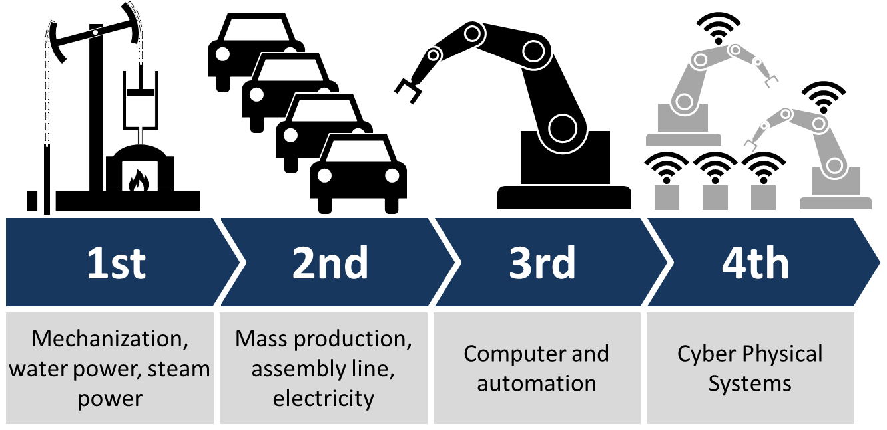
Terms and definitions of industry 4.0 (i4.0)
Source: https://en.wikipedia.org/wiki/Industry_4.0
26/03/2019
SPRINT 4.0 Meeting Bremen - March 2019

Slide 5
Terms and definitions of industry 4.0 (i4.0)
CPS
CPPS
CIM
MES
Semantics
„Future competitiv advantage will be acheived by maintaining control of complexity and complex technologies.“
ICT
PSS
ERP
Cloud Services
MSA
(I)IoT
Ontologies
„ANYTHING“4.0
Cyber Security
PLM
SMART „ANYTHING“
Big Data
26/03/2019
SPRINT 4.0 Meeting Bremen - March 2019

Slide 6
Terms and definitions of industry 4.0 (i4.0)
HUMAN
CPS
TECHNOLOGY
ORGANISATION
26/03/2019
SPRINT 4.0 Meeting Bremen - March 2019

Slide 7
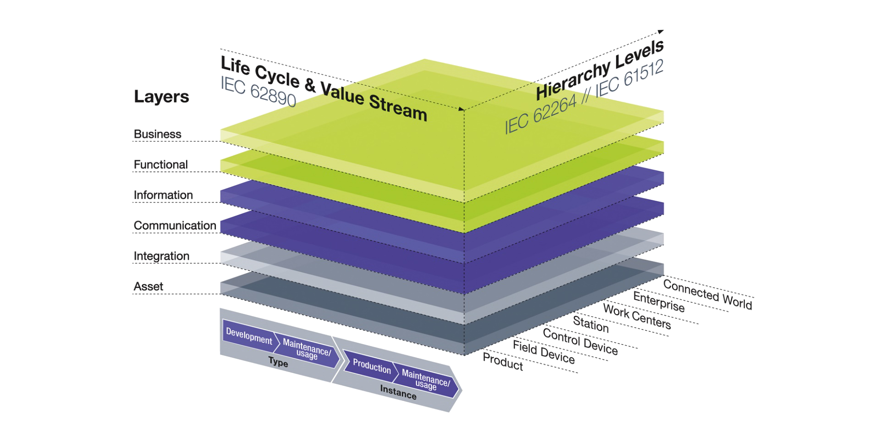
i4.0 Models and Architectures
Source: https://industrie40.vdma.org/en/viewer/-/v2article/render/15557415
26/03/2019
SPRINT 4.0 Meeting Bremen - March 2019

Slide 8
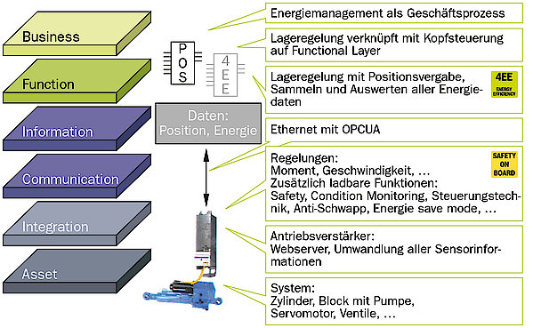
i4.0 Models and Architectures
Energy management as business process
Position control connected with head control on functional layer
Position control with position allocation, collecting and evaluating of all energy-data
Data:
position, energy
Ethernet with OPCUA
Regulations:
momentum, speed, ...
Additional loadable functions:
Safety, Condition Monitoring, Process Control, Anti-slosh, Energy Safe Mode, ...
Engine amplifier:
Webserver, converting of all sensor-information
System:
Cylinder, block with pump, servomotor, valves
26/03/2019
SPRINT 4.0 Meeting Bremen - March 2019

Slide 9
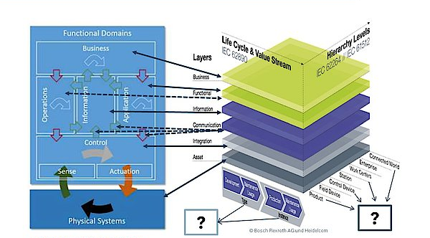
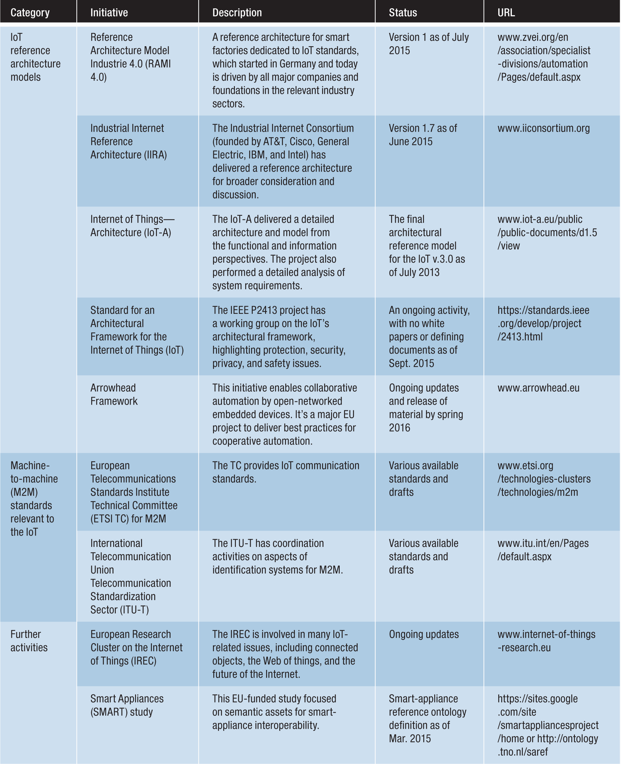
i4.0 Models and Architectures
26/03/2019
SPRINT 4.0 Meeting Bremen - March 2019

Slide 10
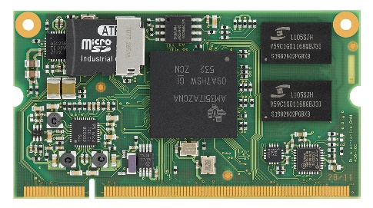

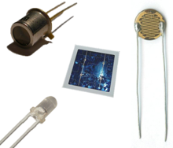

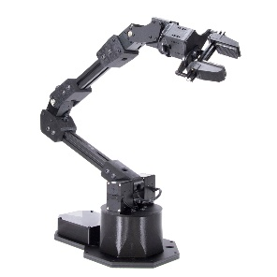



i4.0 Technologies
Embedded systems
Sensors
RTOS
VIRTUAL
(Digital Representation)
PHYSICAL
(Field)
Cloud Systems
security
IEEE 802.X
RFID
26/03/2019
SPRINT 4.0 Meeting Bremen - March 2019

Slide 11
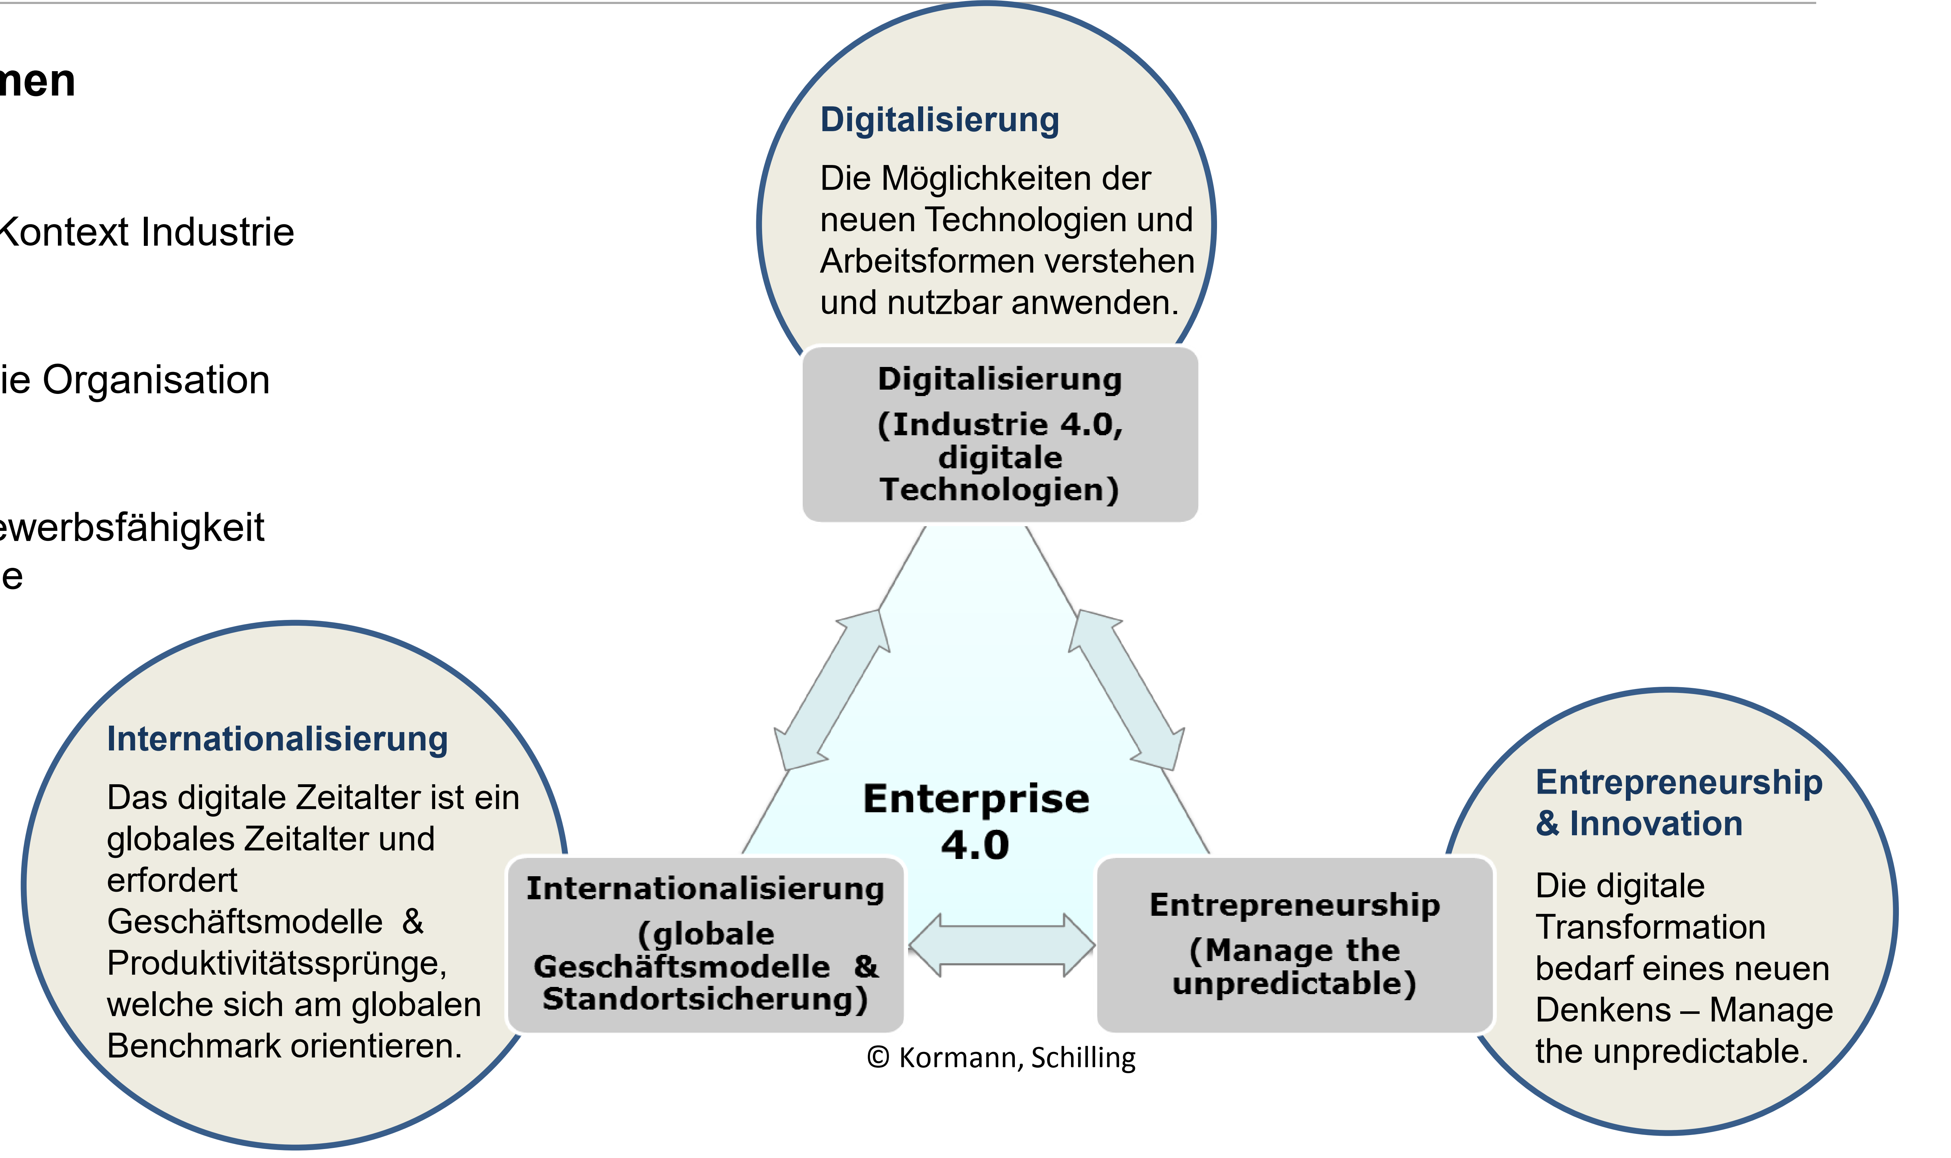
Enterprises in i4.0
Digitalization:
Understanding and using the possibilities of the new technologies and forms of work
Digitalization (Industry 4.0, digital technologies)
Internationalization
The digital age is a global age and requests business models & productivity-jumps, which orientate at the global bench market
Entrepreneurship & Innovation
The digital transformation needs a new way of thinking - Manage the unpredictable
Internationalization
(global business models & location guarantee)
Entrepreneurship
(Manage the unpredictable)
26/03/2019
SPRINT 4.0 Meeting Bremen - March 2019

Slide 12
Challenges in i4.0
seamless integration of devices → interoperability
Facilitating „right“ technologies
ROI for application of new technologies
Holistic viewpoint → added value is not only by technology but business processes as well
Maintaining control of complexity → System-of-systems approach
26/03/2019
SPRINT 4.0 Meeting Bremen - March 2019

Slide 13
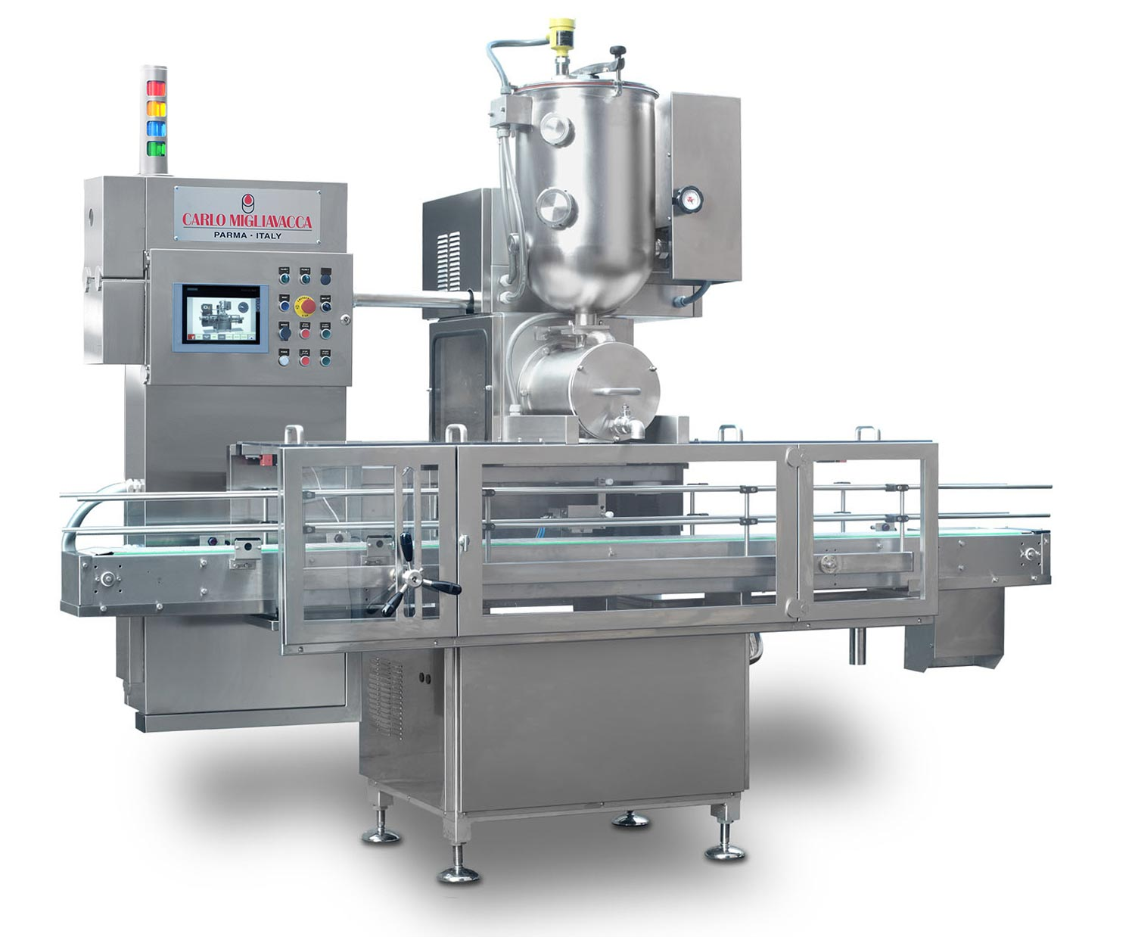



Industrial Use Cases -
predictive maintenance
Maschine is broken
Cloud
Maintenance
Advantages | Disadvantages
Efficient productivity | Needs highly specialized skill level
Reduces unplanned downtime | High investment
Cost effective | Much time needed to schedule tasks
Saves energy and resources
Difference to industry 3.0:
Machines are able to identify mistakes and communicate them.
Source: https://www.carlomigliavacca.com/en/mushrooms-filling-machines-dc240.php
https://www.git-labor.de/forschung/chemie-physik/janus-teil-1-das-projekt-fortschrittliche-chromatographie
https://blog.trginternational.com/introduction-to-predictive-maintenance-techniques

Slide 14
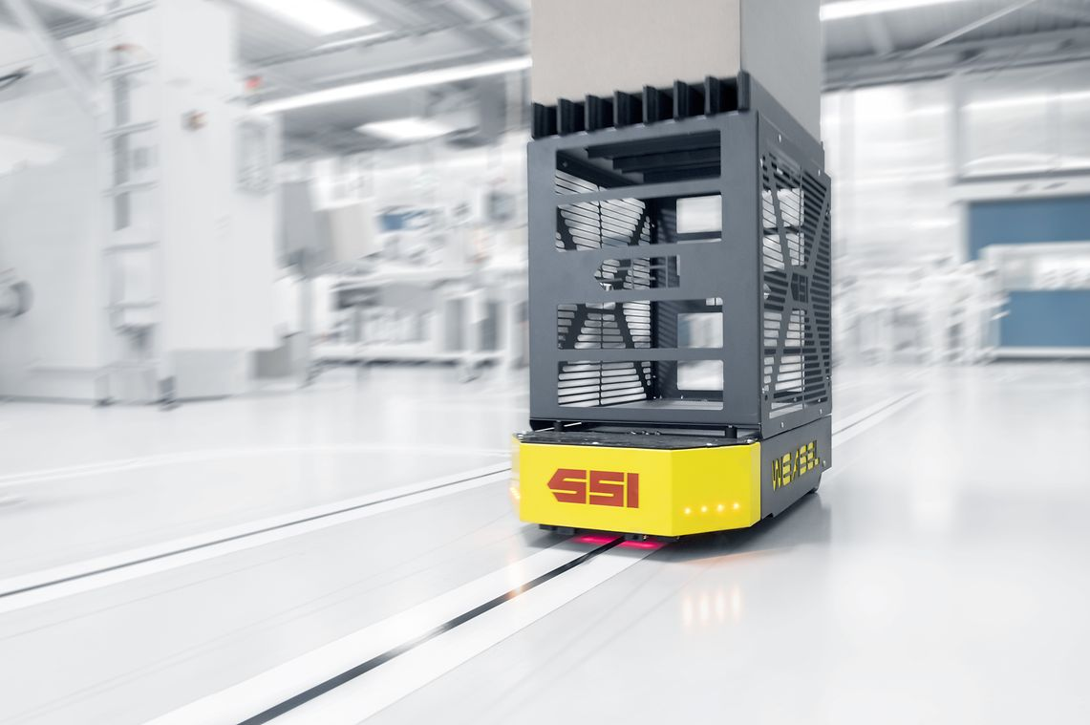
Industrial Use Cases -
automatic guided vehicles (AGVs)
AGVs are able to perform simple tasks on their own.
Advantages | Disadvantages
Reduces labor costs | High investment
Increases safety | Only for repetitive tasks
Increases accuracy and productivity | Decreases flexibility of operations
Easy to expand
Difference to industry 3.0:
No more labor needed for guiding the vehicles.
Source: https://www.ssi-schaefer.com/en-us/products/conveying-transport/automated-guided-vehicles/fahrerloses-transportsystem-weasel-53020
https://www.conveyco.com/advantages-disadvantages-automated-guided-vehicles-agvs/

